Slide 1

Design of Low Phase-Noise Microstrip Resonator Oscillator
Presentation for the Degree of Bachelor of Technology in Electronics and Communication Engineering of National Institute of Technology Durgapur
Anish Pandey, Aman Agarwal
Roll No.13/EC/93 Roll No. 13/EC/86
Under Supervision of
Dr. Rowdra Ghatak
2017
Microwave and Antenna Research Laboratory
Department of Electronics and Communication Engineering
राष्ट्रीय प्रोद्योगिकी संस्थान दुर्गापुर
National Institute of Technology Durgapur
Mahatma Gandhi Avenue, Durgapur-713209, West Bengal
INDIA

Slide 2
Microstrip Design
best known and most widely used planar transmission line for RF and Microwave circuits.
ease of fabrication using various processes, easy integration with solid-state devices, good heat sinking, and good mechanical support.
Radiation Losses depend on the dielectric constant, substrate thickness, and the circuit geometry.

Slide 3
Lumped Microstrip Components
The inductance value of a Microstrip inductor is determined from the total length, the number of turns, spacing, and line width.
Narrow tracks are more inductive but carry less current, so there is a trade-off between them
The coupling gap acts as a Capacitor in the microstrip circuits.
These two parameter mentioned above are responsible for Resonant frequency produced by the resonator

Slide 4
Microstrip Resonators
A Microstrip Resonator is any structure that is able to contain at least one oscillating electromagnetic field.
Microwave resonator are used in variety of applications, including filters, oscillators, frequency meters, and tuned amplifiers.
Modern communication systems require low phase noise, low cost, compact high Q factor resonator.
Furthermore, fully planar type resonators have been developed to be applied in Monolithic Microwave Integrated Circuits(MMIC) and satisfies the above conditions..

Slide 5
Thus we have observed the effect of change in parameters on six different shapes of planar resonators . These are named as :
1.Split ring Resonator
2.Hairpin Shape Resonator (multi band)
3. Hairpin Shape Resonator (mono band)
4.Double Spiral Resonator
5.Single Spiral Resonator
6.Quadral Spiral Resonator

Slide 6
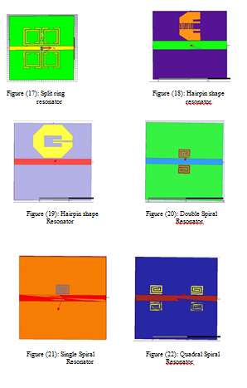

Slide 7
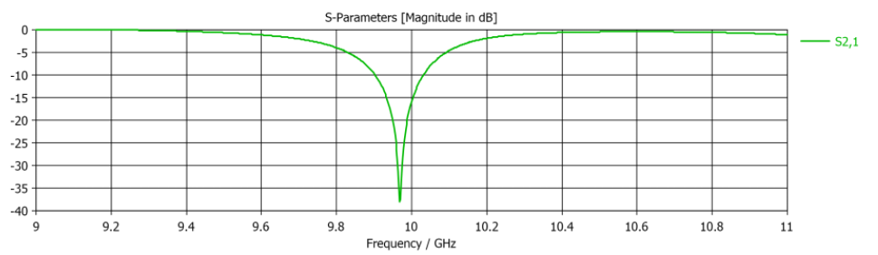
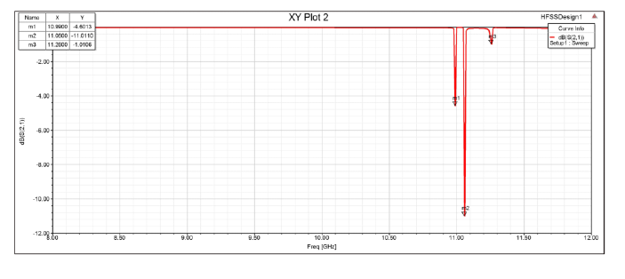
S21 parameter of Split ring resonator
S21 parameter of Hairpin Shape resonator (mutliband)

Slide 8
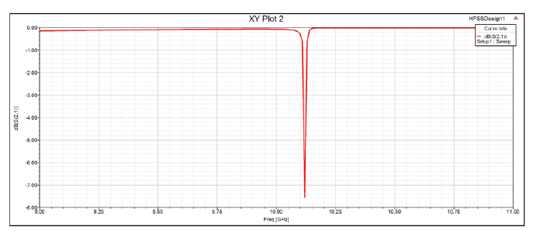
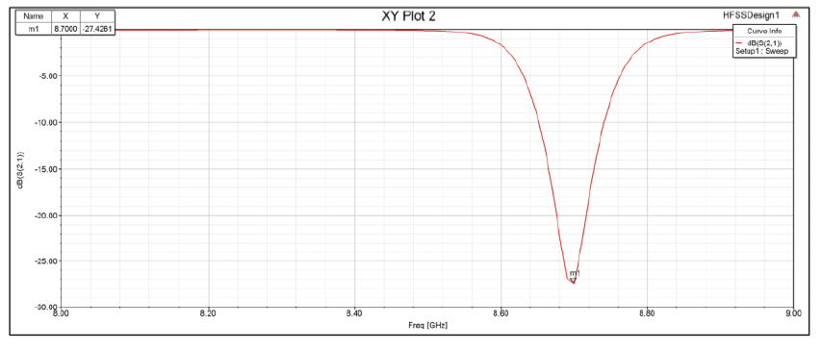
S21 parameter of Hairpin Shaped Resonator (mono band)
S21 parameter of Double Spiral

Slide 9
S.No. | Name of the resonator | Resonant frequency
1 | Split ring resonator | 9.9677 GHz
2 | Hairpin shaped resonator | 10.99GHz,11.06GHz,11.26GHz
3 | Hairpin shaped resonator1 | 10.12 GHz
4 | single spiral resonator | 10.28 GHz
5 | double spiral resonator | 8.7 Ghz
6 | Quadral spiral resonator | 8.75 GHz
Hairpin Shaped Resonator (1) , single spiral Resonator and Split ring Resonator are best for resonating nearly with 10 Ghz frequency and also have very high Quality factor .
Hairpin Shaped Resonator has multiple resonating frequency and shows multiband property

Slide 10
Oscillators
The circuits that are used to produce a periodic signal are called oscillator circuits.
The basic function of the oscillator circuit is to convert a fragment of DC power into an output which is periodic in nature.
For an efficient oscillator design, it is required to have a nonlinear active device. In our case we have taken GaAs FET Transistor
When the voltage and current are out of phase by 180 degrees, it leads to negative resistance and is related to power generation. Negative resistance is a very important concept for an oscillator

Slide 11
Oscillator design
Microstrip resonator oscillator consists of active device, a resonator at operating frequency, RF choke network, DC bias circuit and output matching network
The microstrip resonator oscillator is designed to make the resistance generated by the feedback element negative enough to compensate the loss generated by the resonator.
RF Choke coil-The DC voltage is supplied to the active device, at the same time it blocks the RF signal generated by an active device from going to the power supply circuit. If the RF leaks to the power supply circuit, it will reduce the gain and produce instability of the output frequency.
DC Bias Circuit- VDD supply is 3V, ID is 10 mA, VDS is 1.5 V. Since oscillation of GaAs FET (HEMT) can be operated when we have negative Vgs voltage .hence we have applied -0.4 V at Vgs.

Slide 12
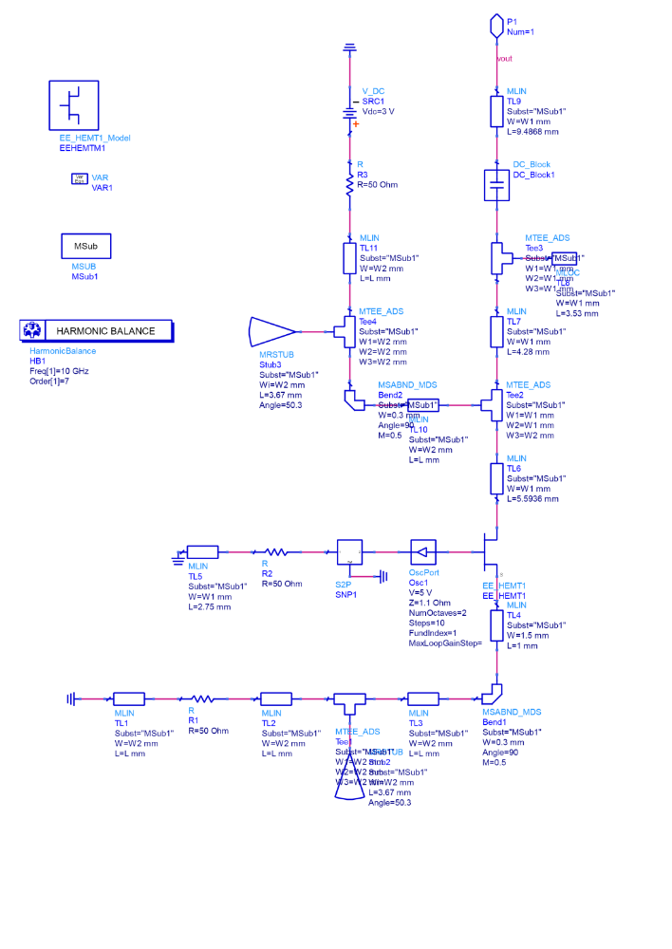
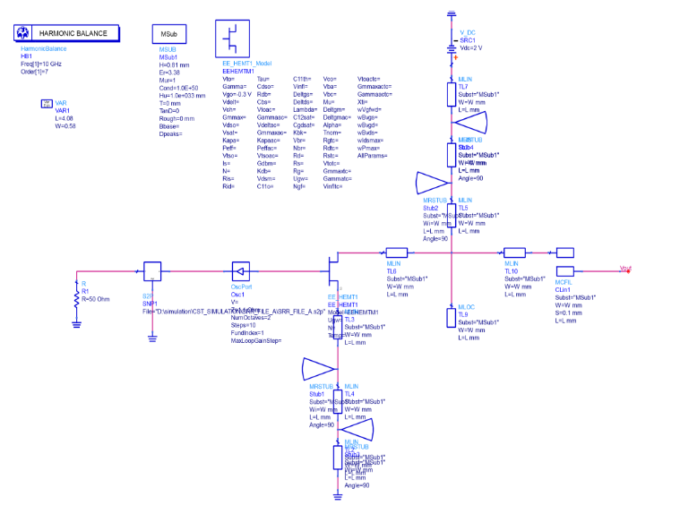
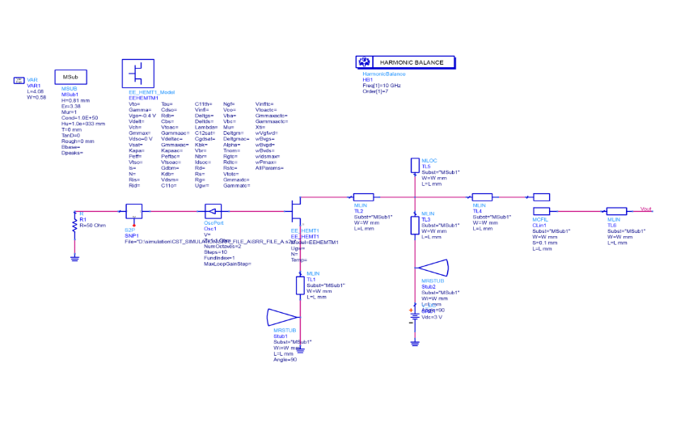
Oscillator Architecture
Oscillator design 1
Oscillator design 3
Oscillator design 2

Slide 13
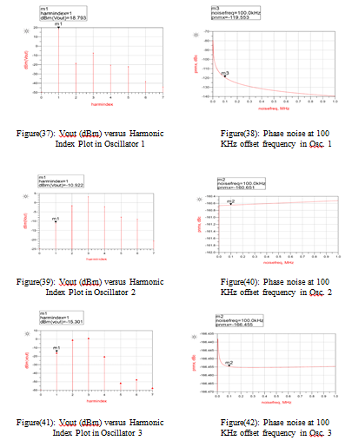

Slide 14
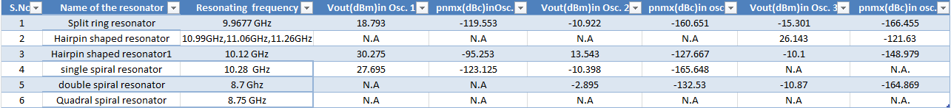
From the above comparison, oscillator designed 3 is most accurately designed oscillator which gives minimum phase noise at 100 kHz offset frequency whereas, oscillator 1 comes worst in terms of better result as phase noise is very high and the output voltage is high indicating the power loss.

Slide 15
THANK YOU
UG Project Presentation 2014
Microwave and Antenna Research Laboratory
Department of Electronics and Communication Engineering
राष्ट्रीय प्रोद्योगिकी संस्थान दुर्गापुर
National Institute of Technology Durgapur
Mahatma Gandhi Avenue, Durgapur-713209, West Bengal
INDIA

